Slide 1
Neural Networks From Scratch
A brief History Lesson, What Neural Networks are, Neurons, Neurons, and More Neurons
Robert Moseley
California Baptist University
College of Engineering

Slide 2


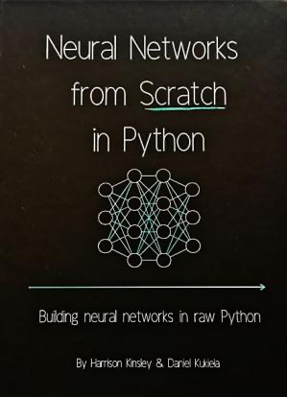
Before we Begin…
How to Follow Along:
Use any laptop
Python 3.7 or later
Numpy v1.15.0 or later
No Experience required
Book we will be learning from:
- Neural Networks from Scratch in Python (Harrison Kinsley & Daniel Kukiela)

Slide 3
A quick note…
Neural networks can be complicated!
I don’t understand many things about neural networks (most people don’t)!
Don’t get overwhelmed, let’s do this one step at a time!

Slide 4
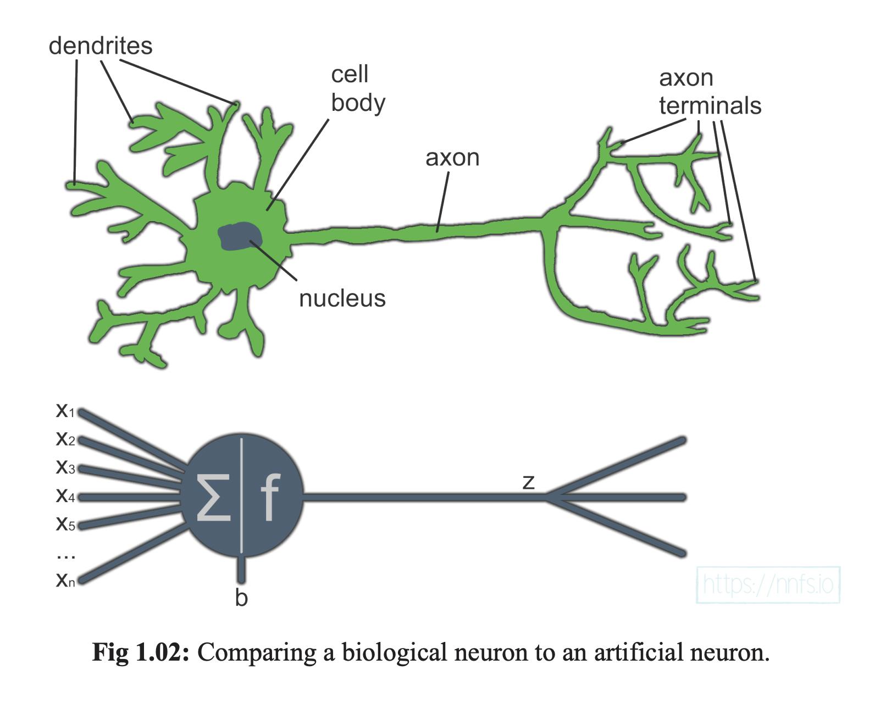
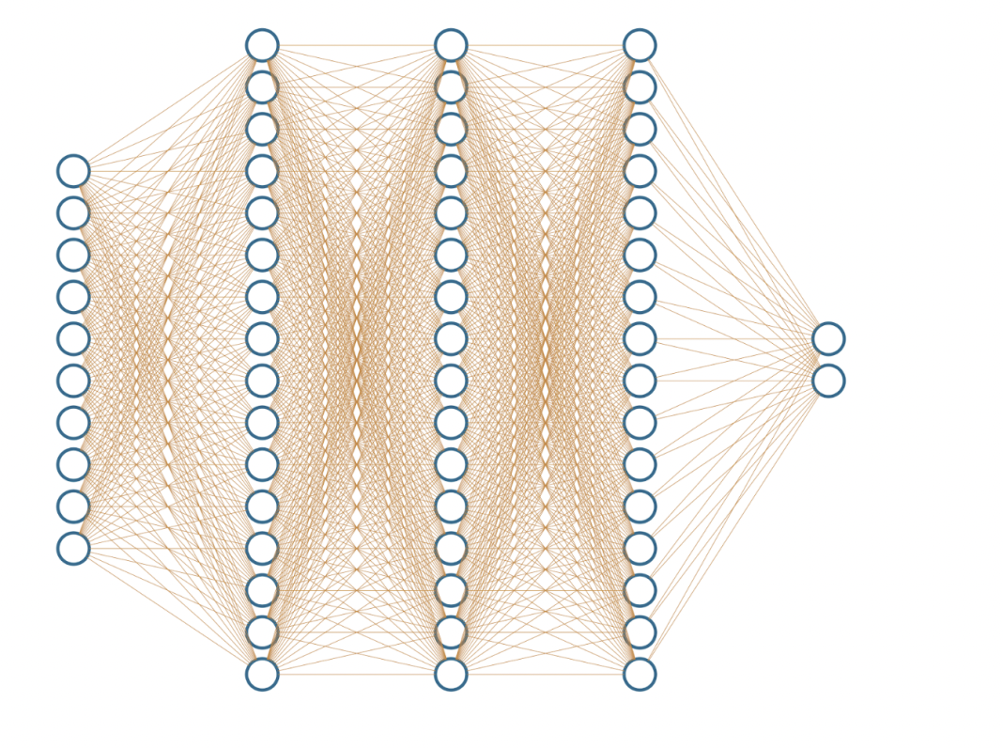
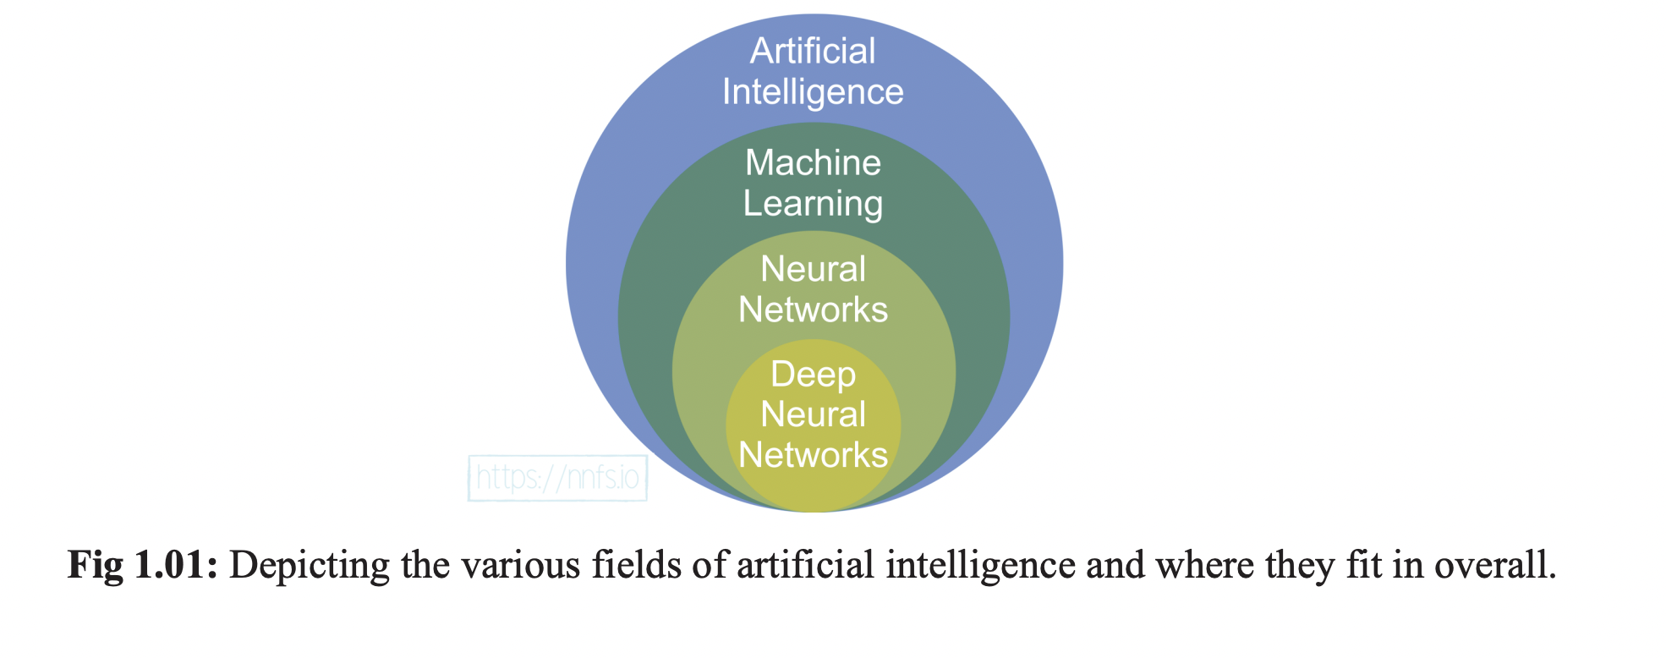
Overview of
Today’s Lesson
History of Neural Networks
What are neurons? How do we make them?
What is a Neural Network?
Notes:
Let’s talk about what we are going to learn today, and what order we will cover topics in

Slide 5
Question: Have you heard of neural networks? Where did they come from?

Slide 6
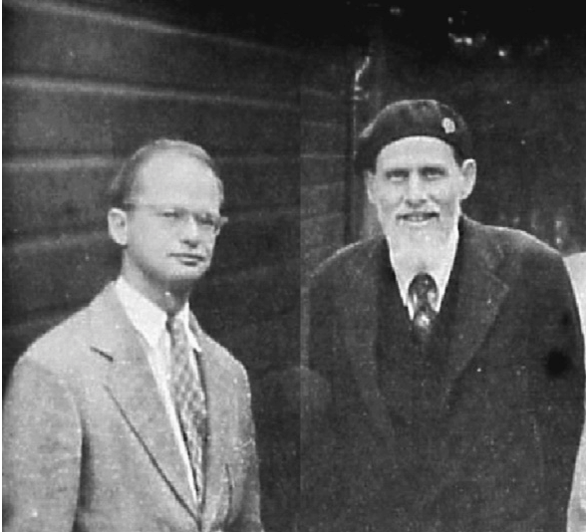
Time for a History Lesson
Neural Networks first proposed in 1944 by Warren McCulloch and Walter Pitts
University of Chicago Researchers who later started MIT Cognitive Science Lab
Just an idea at first, nobody knew how to actually train the networks for 20 more years
Notes:
Neural Networks or Artificial Neural Networks (will be using the term Neural Networks, but they are interchangeable)
First proposed by Warren McCulloch and Walter Pitts in 1944 who were Cognitive Scientists at the University of Chicago and later moved to MIT to start their Cog Sci Lab
Neural Networks originated in the 1940s, but nobody could figure out how to train them until nearly 20 years later when backpropagation was invented (something we will get into in the next meeting time)
Basically, it was only a theory that people thought could be really useful, but nobody could figure out how to implement the theory (computers weren’t powerful enough anyway)
Neural networks took until nearly 2010 before they started to become popular (this is when they started to win competitions against actual humans)
McCulloch and Pitts built on ideas from Alan Turing’s book “On Computable Numbers” and demonstrated how brain functions could be described in the context of formal mathematics

Slide 7
Neural Networks are based upon the structure and functionality of biological neurons
Notes:
While a biological neuron might have dendrites and cell bodies for processing inputs, a neural network relies upon mathematical functions to handle the same processes
Neural networks have neurons, which are basically just the nucleus, and every input to the neurons can just be thought of as the dendrites
Modern neural networks are based upon the real, biological structure of the human brain! It’s really amazing.
This is also why cognitive scientists have been some of the most important people pushing this field forward!

Slide 8
What is a Neural Network Anyway?
Notes:
I am sure all of you are dying to know at this point, what is a neural network? Well, now that we know where they came from, let’s talk about what they are and what they actually do.

Slide 9
Questions: Can you think of any examples of Neural networks? What do you think of when you hear the term machine learning?

Slide 10

Notes:
When people mention AI, your mind might immediately go to something like this (which is a nice idea, but not quite reality)

Slide 11

Notes:
Or you might even think of something like this (a bit more frightening and science-fictiony than the previous image)

Slide 12
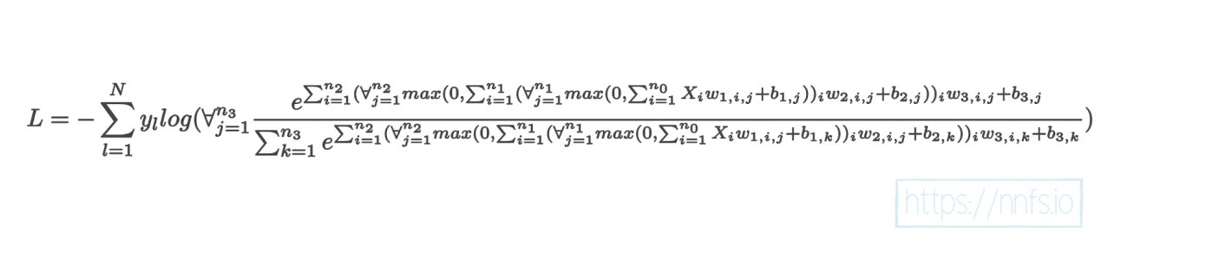
Or maybe you just think of Neural Networks as the scary mathematical functions that represent them…

Slide 13

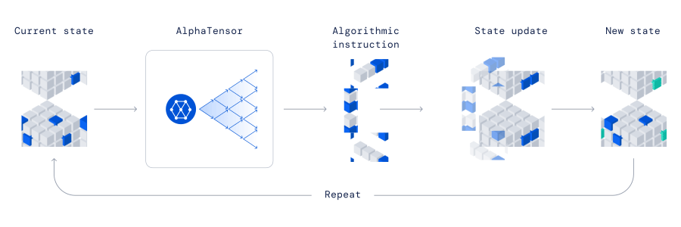
The reality of Neural networks is both incredibly exciting, and not at the same time
Notes:
Question: does anyone know what this robot is or who made it?
The truth about neural networks is that we (computer scientists) are making amazing progress towards really incredible AI inventions, but we definitely are not yet capable of making something like the terminator or full self-driving cars.
This is why it’s important for all of us to keep learning about them, so we can keep pushing the field forward.

Slide 14
Neural Networks Represent a Small Subdomain of Artificial Intelligence
Notes:
Artificial intelligence can mean many different things, so it is important that we are clear when we are talking about neural networks
Even machine learning is not as specific as some people believe it to be, it even encompasses what some people would label “simple” algorithms
The term neural network has to do with the structure of the algorithms and how they process data,
And the term deep neural network has to do with the overall size of the network (though this label is slightly ambiguous as there is no specific size that represents a neural network being “deep” it is more of a you know it when you see it type situation)

Slide 15
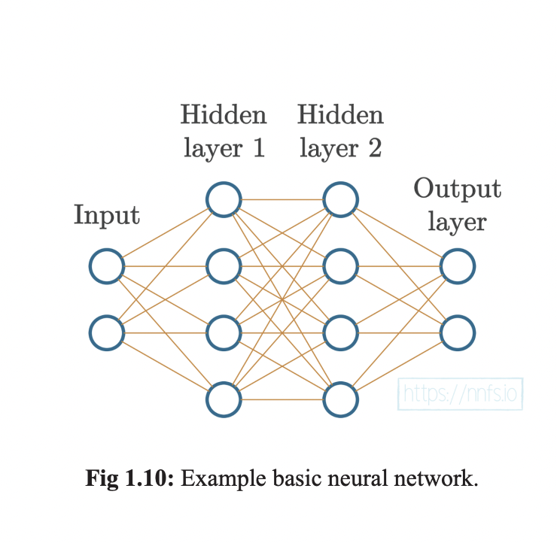
Neural Networks can be simple or...
Notes:
This is an example of what a small neural network looks like ”under the hood”
Really simply – just a bunch of small connected neurons that process data in different ways

Slide 16
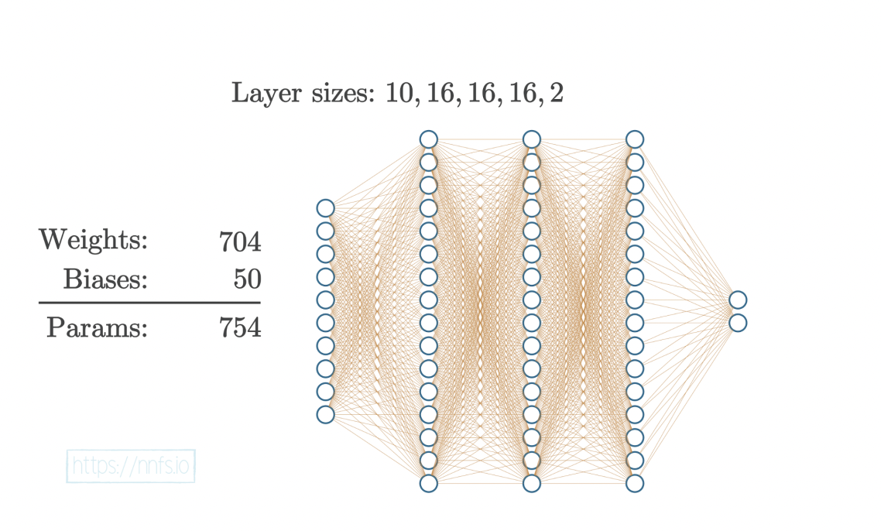
Neural Network Structure is inspired by the Brain
They are comprised of layers upon layers of individual neurons where each neuron has the responsibility of communicating a signal to the rest of the network
Notes:
Neural networks have different layer types:
1) Input layers
2) Hidden layers
3) Output layers
Input layers is where data starts out in a neural network – it is given in its raw, unfiltered form before the network manipulates it
Hidden layers are inaccessible to the creator of the network – these layers are responsible for parsing the input data and manipulating it until the data makes sense
Output layers are where the perceived answer generated by the network is actually read from
If you are performing classification, say dogs and cats, then one neuron represents that the network thinks it found a dog, and the second neuron represents that it thinks it found a cat
This network featured above represents what we would call a fully connected neural network because each node in one layer is connected to every node in the previous and subsequent node layers. The output of each node, becomes the input for its connecting node until the output layer is reached.
There are many different types of neural networks including recursive neural networks (which is best used for time series data), convolutional neural networks (best used on images and videos – think Tesla self-driving cars), Long Short-Term Memory (LSTM) which are great at shorting long sequences of data
We will focus on simpler neural networks, like the one featured in this picture, to keep explanations a little bit simpler

Slide 17
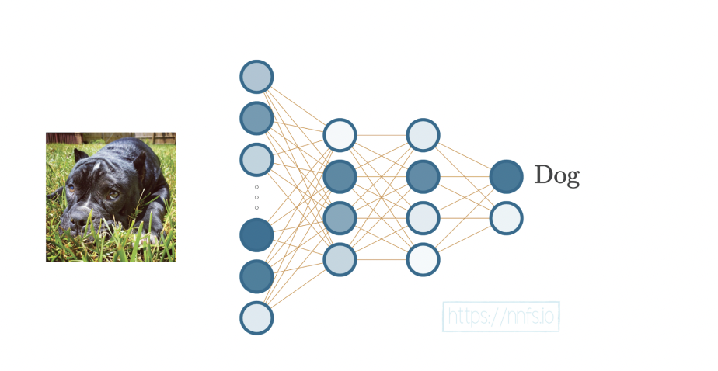
Notes:
Here is an example of a neural network that classifies images as a dog or a cat
The specific sequence of neurons that are lighting up here are highlighting the output neuron that indicates the image is a dog!

Slide 18
Question Break

Slide 19
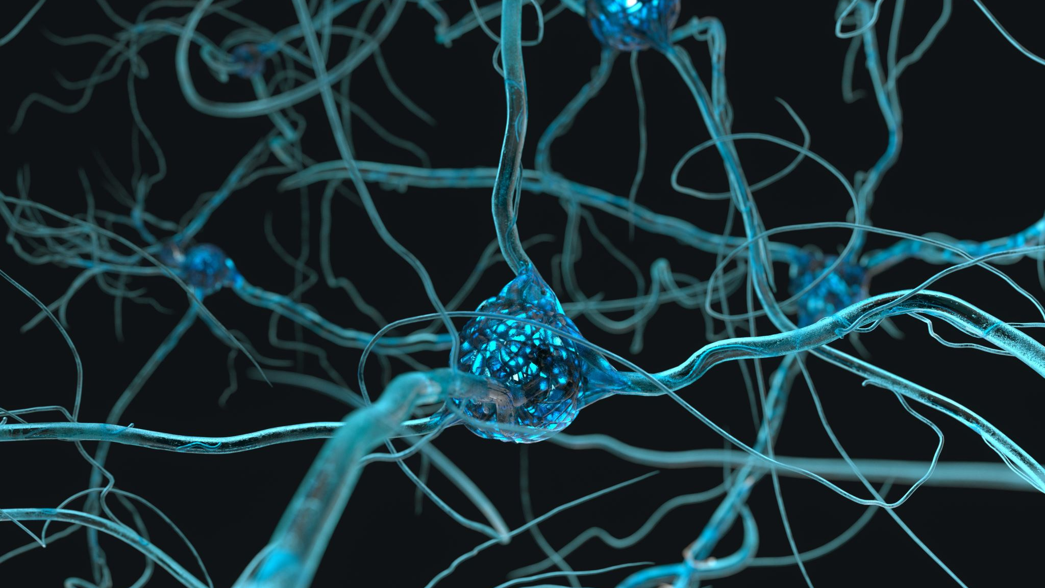
What are Neurons and how do they work?

Slide 20
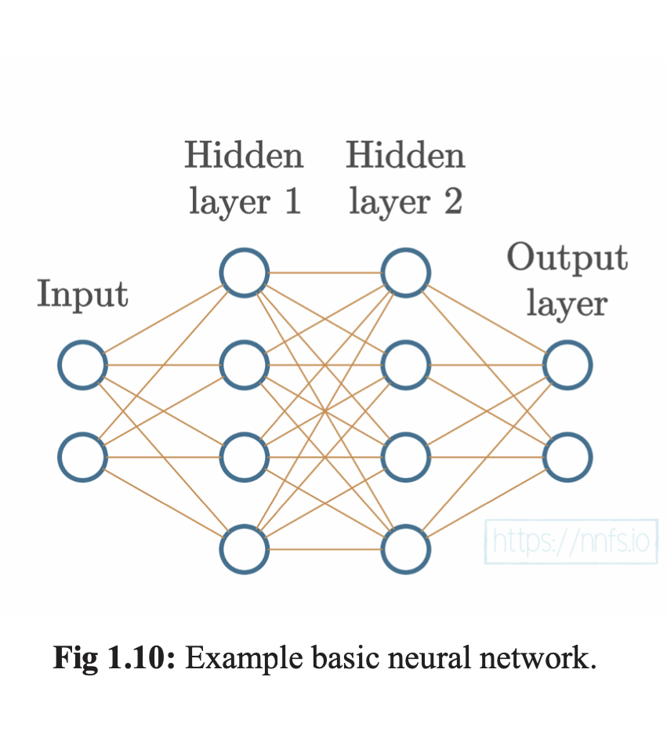
Each Neuron here has:
A list of inputs
Each input has a weight
Each neuron has a bias
If you ever hear, inputs, weights, or bias just think “oh, a number!”
Notes:
The inputs refer to the specific lines that go from neuron to neuron
The weights are the values attached to each line
And the bias is a third number that is tuned in a neuron over the training period that changes based on the data you give it.

Slide 21
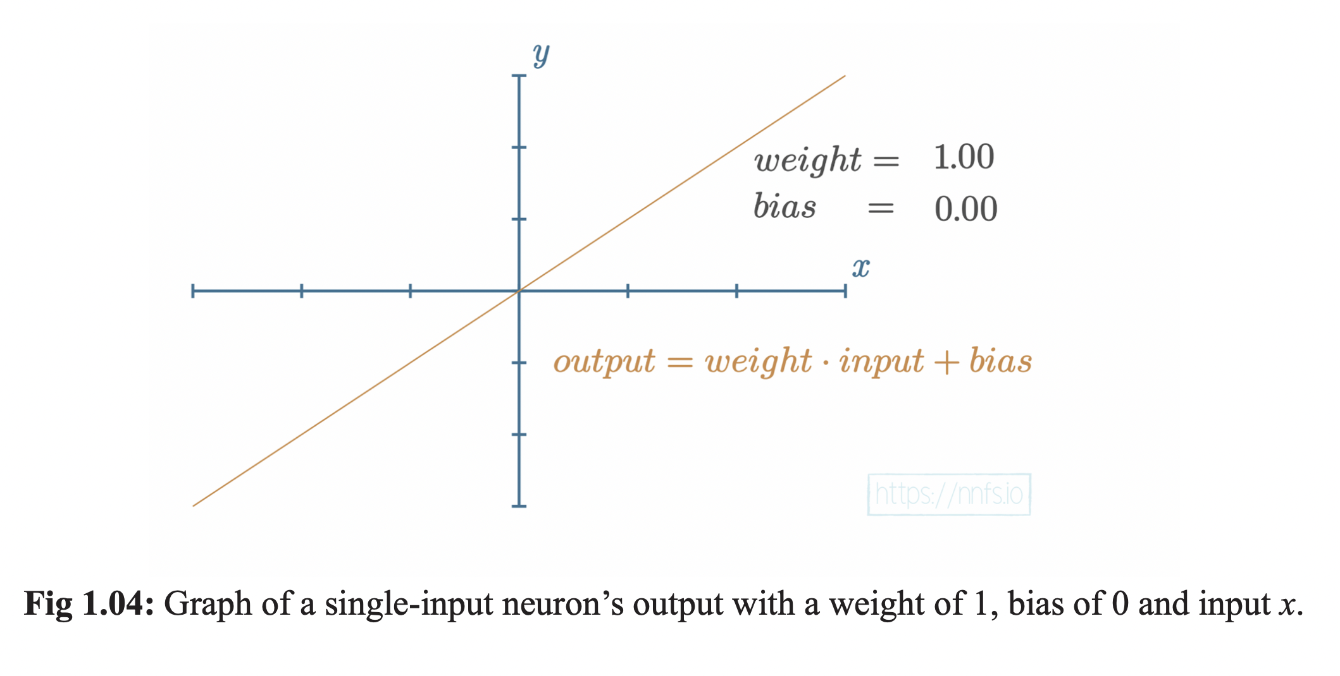
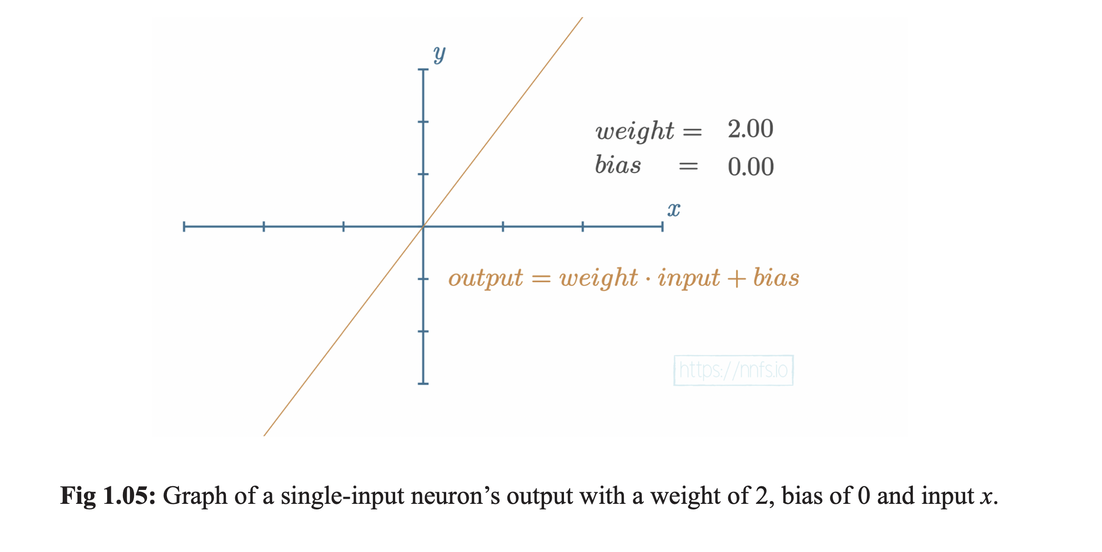
Notes:
Neurons are just numbers!
They are composed of weight and bias and training a neural network is basically just the process of changing these numbers
using mathematical functions
As you increase the value of the weight, the slope will simply get steeper. If the weight is decreased, the slope will decrease
Similarly, if the weight is negated the slope will turn negative!

Slide 22
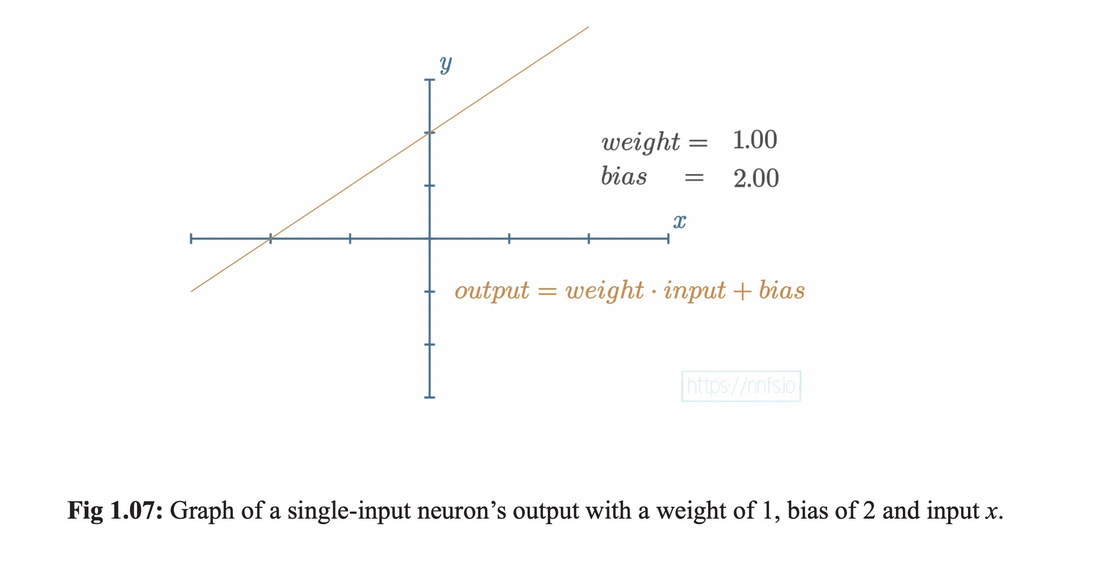
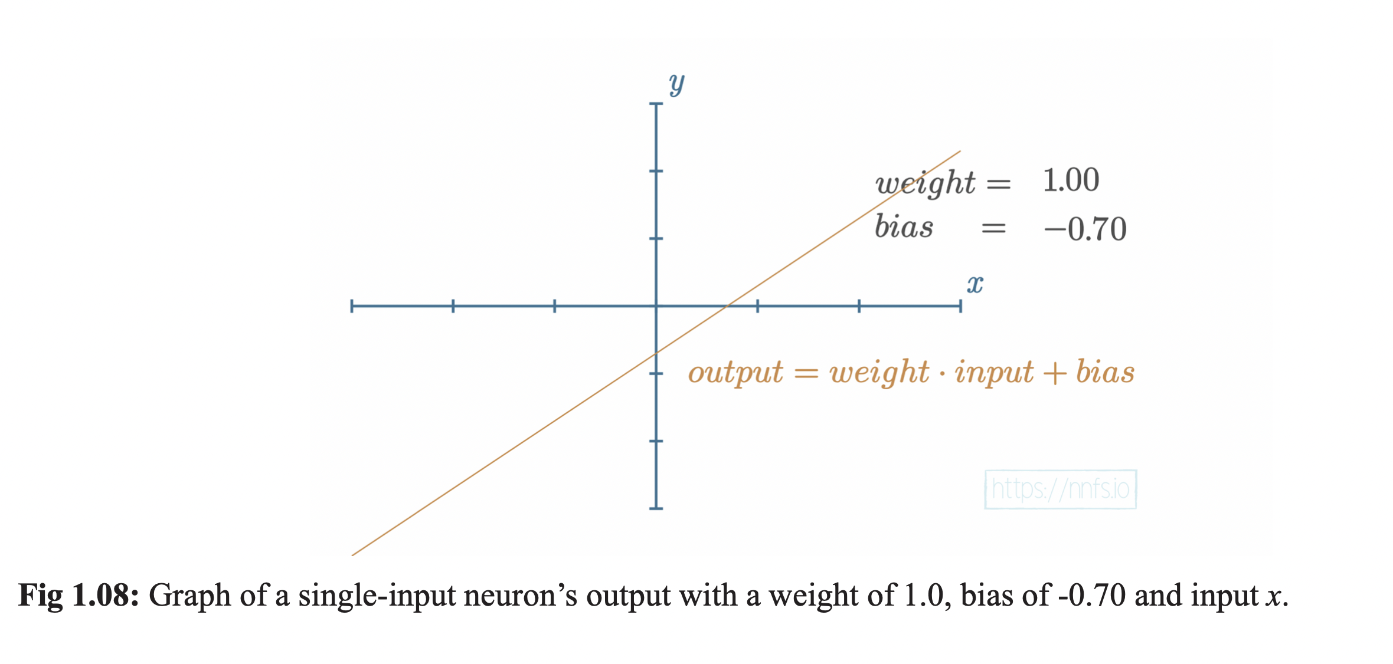
Notes:
Adjusting the bias of the neuron simply allows us to shift the output up or down on the y axis
Think of weight as the slope of the output line, and the bias as the the linear adjustment that determines when the output is positive or negative

Slide 23
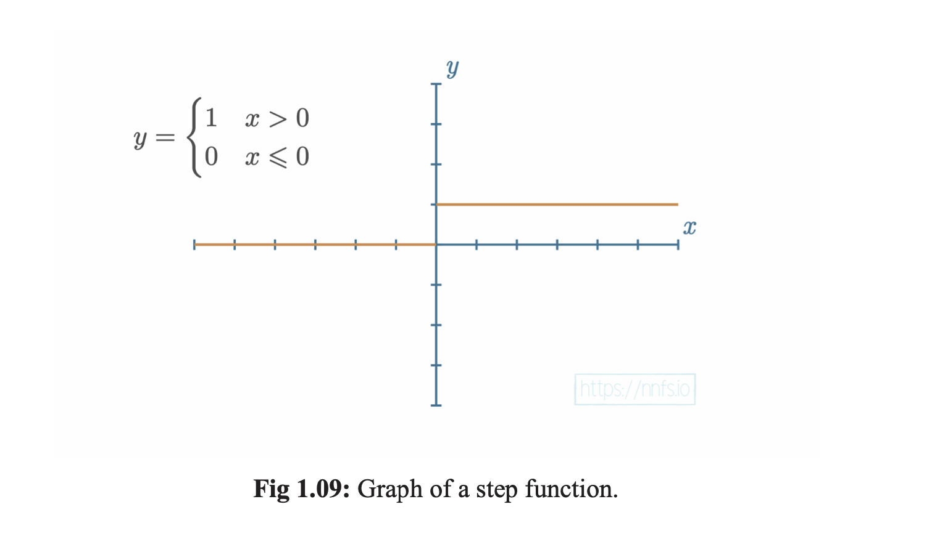
Brains don’t have “complex” neuron functions
Notes:
Neurons in the brain are either “on” or “off” there is no in-between value, there are no positive or negative values, 0 or 1 only.
Neural networks are different (and maybe better) because they can represent potentially more values in a smaller space

Slide 24
Again, Each neuron here has weights (the lines going into the neurons) and a bias that is a single number

Slide 25
Weights and Biases impact the output that neurons represent, but what math is applied to them to change the values?
Notes:
This is accomplished using activation functions and a technique called back propagation, which we will discuss in a future lectures!
For now, just focus on the idea that each neuron in a neural network contains a specific value that changes overtime in response to data you give the network.

Slide 26
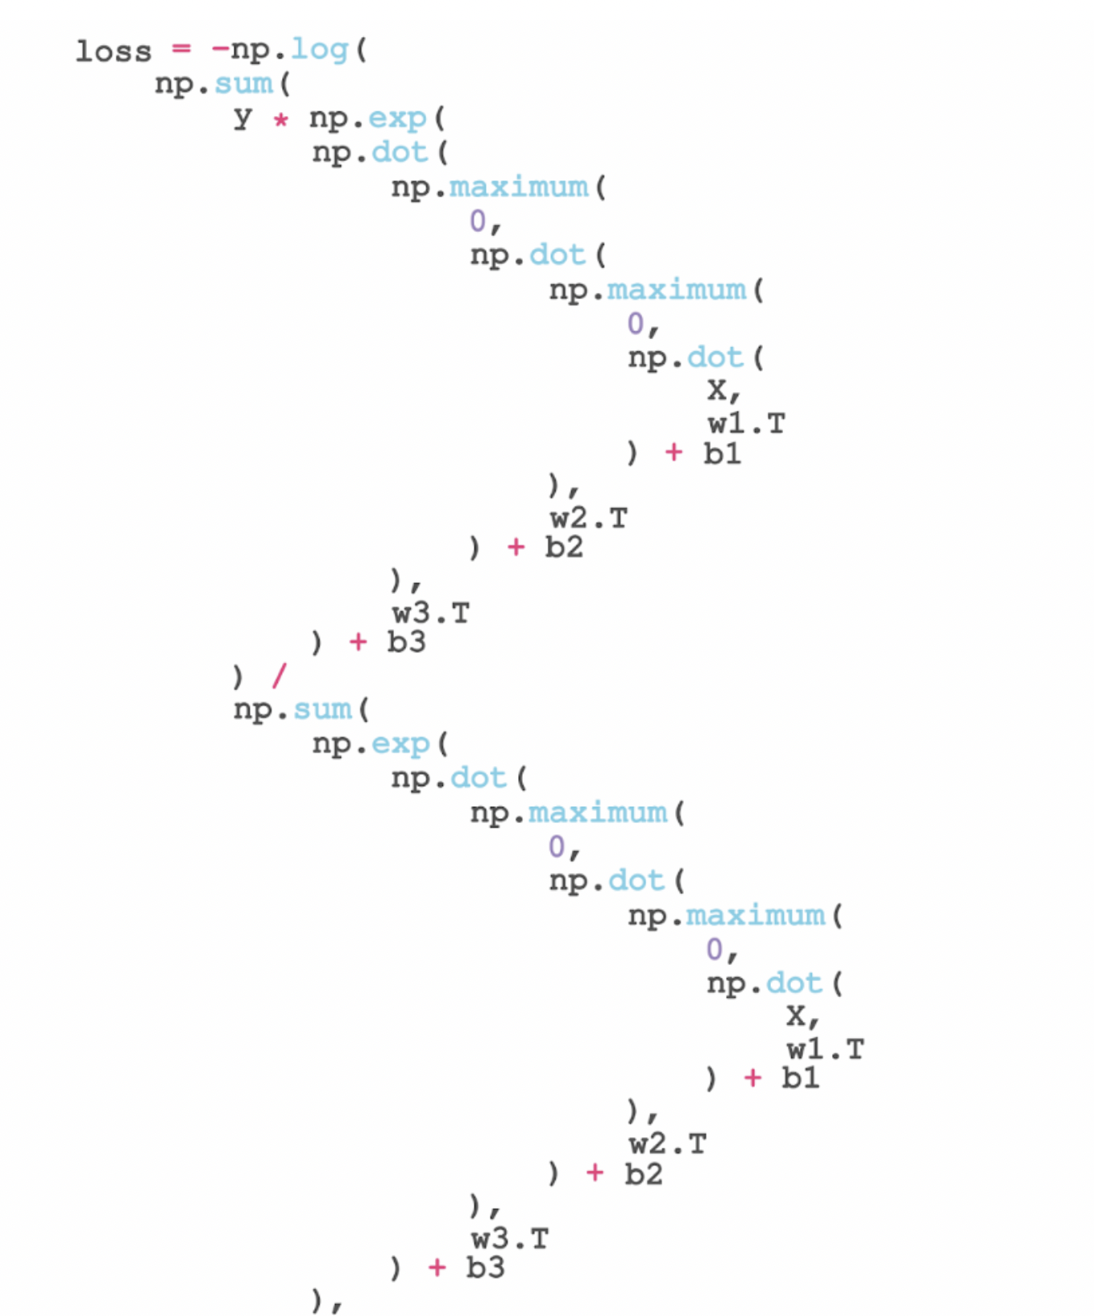
Without machine learning libraries, we would end up with code that looks like this!
This is a manual calculation example of weights and biases in a neural network.
Neural Networks can have millions or even billions of weights and biases to add together
Notes:
A weight + bias combo is known as a parameter! Each input to a neuron is a parameter.
All parameters are tuned in the process of training a neural network, some are more accessible than others
Most parameters in hidden layers are not modified manually, but change in response to the data you give the network.

Slide 27
Question Break

Slide 28
How do we Code individual Neurons?

Slide 29
Let’s write some Code!

Slide 30
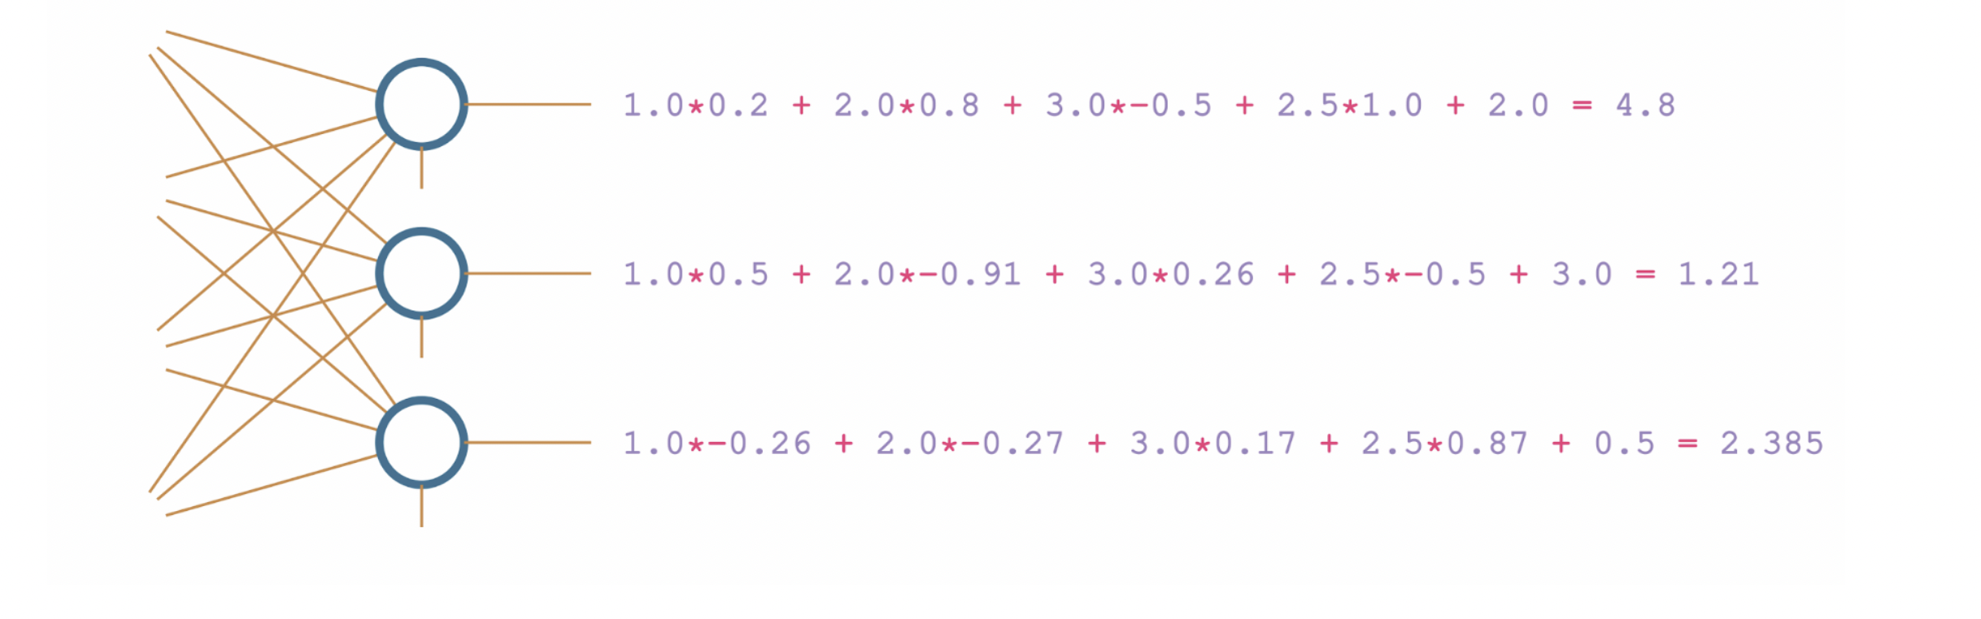
What did we create just now?

Slide 31
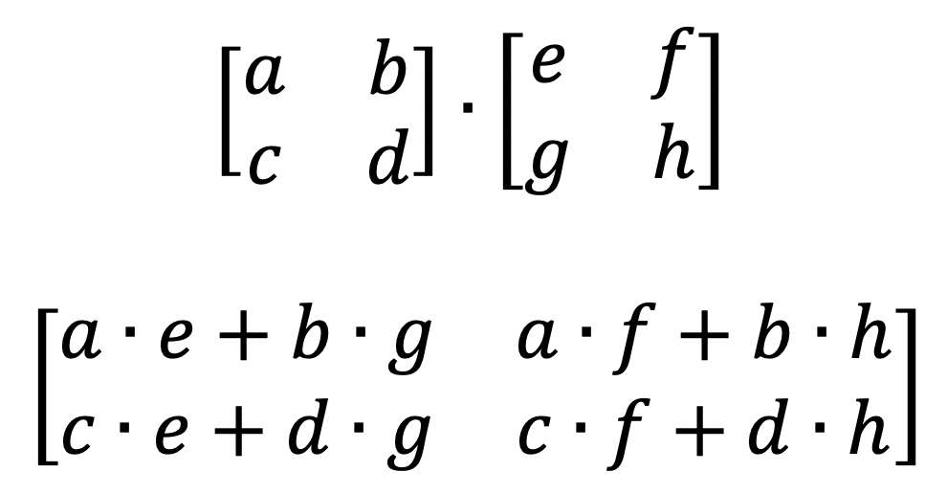
Why We transposed the Weights in our code
Notes:
In order to correctly perform dot product, transposition is a necessary step to attain the correct values we want in the network
If you are not familiar with dot product, it’s really simple to understand, we are simply multiplying the rows of the left matrix with the columns of the right matrix
When you take linear algebra or numerical methods later on in your degree you will learn about dot product and what it does in better detail

Slide 32
Summary of Today’s Work
We learned about the history of Neural Networks, who created them, and why they look the way they do
1
We learned exactly what a neural network is, and how it’s not as frightening as you might think
2
We talked about the structure of neural networks and how they are composed of individual neurons
3
We finished by coding individual neurons and layers of neurons!
4

